Slide 1
Introduction to Machine Learning
Outlines
What is Machine Learning
Why use Machine Learning
ML Applications
Types of Machine lea

Slide 2
What is Machine Learning?
Machine learning (ML) is concerned with the development and study of statistical algorithms that can learn from data and generalize to unseen data.
Learning from data without explicit programming.
The Spam filter
  Deductive reasoning or Traditional approach
    Rules + Data → Answers
    A human expert has to write every single rule manually
    A new email, treated as data, is validated against each rule to mark it as spam or not-spam
  Inductive Reasoning or ML
    Data + Answers → Rules
    10 millions past emails (text, metadata, time, server ip, etc)
    Information that out of 10 million, these 50,000 emails were spams and the rest 9.95 millions were legitimate
    The ML algorithm finds the Rules as mathematical signature.

Slide 3
What is Machine Learning?
Rule + Data → Answers
Data + Answers → Rules
Data
100 million emails (The text, the metadata, the time sent, the server IP, the link structure)
Answers
We give the machine two folders: "This is Spam" (labeled by users) and "This is Inbox" (safe mail).
The Rules (The Model): The ML algorithm doesn't just look for words. It finds mathematical signatures. It notices: "ML detects: 99% of spam has a specific image-to-text ratio and comes from servers active for only 2 hours.“
The Result: The machine creates a complex "Rule" (a probability model). Even if the spammer writes "W-I-N-N-E-R", the machine sees the behavioral pattern and blocks it.
Rules
IF (Subject contains ‘WINNER’) THEN ‘Spam’
IF (Subject contains ‘FREE LOTTERY’) THEN ‘Spam’
IF (Sender is unknown@stranger.cm THEN ‘Spam’
Data
1. A new email arrives: “WINNER, Get your Free Lottery win. Claim $50,000,000’”
2. Another email arrives: “W-I-N-N-E-R, Get your free Win. Claim $50,000,000’
Answers: Email 1→ Spam
Email 2 → legitimate (sneaked though!)

Slide 4
What is Machine Learning?
Traditional programming
Machine Learning
In Machine Learning, the data provides the logic.
Human provides the Logic
Feature | Traditional C++ Program | Machine Learning Program
Input | Data + Rules (Code) | Data + Answers (Labels)
Output | Answers | Rules (The Model)
Logic | Explicit: You write every if/else and for loop to handle specific cases. | Implicit: The algorithm finds patterns in the data that you might not even see.
Examples | "If the user's age > 18, allow access." | "Based on 1 million users, people with these 50 traits are likely to buy this product."

Slide 5
What is Machine Learning?
Arthur Samuel (1959)
Field of study that gives computers the ability to learn without being explicitly programmed
Tom Mitchell (1998)
- A computer program is said to learn from experience E with respect to some task T and some performance measure P, if its performance on T, as measured by P, improves with experience E

Slide 6

Tom Mitchell (1998)
Let $M_{E}$ be the program/model after training on experience $E$. then $M$ learns iff:
P(M_{E}​,T) improves as E increases
For two experience levels $E_{2}$ and $E_{1}$, where $E_{2}$ contains more experience than $E_{1}$:
E₂​⊃E₁​ ⇒ P(M_{E2}​​,T)>P(M_{E1}​​,T)
- More E → Better P on T

Slide 7
Tom Mitchell (1998)
Symbol | Meaning
T | Task (classifying cats vs dogs)
E₁ | Experience 1 ( 100 images of cats and dogs each)
P₁ | Performance measure (e.g. 20% accuracy)
E₂ | Experience 2 ( 10,000 images of cats and dogs each)
P₂ | Performance measure (e.g. 95% accuracy)

Slide 8
Why Use Machine Learning?
Problems too complex for human rules
  How do you write code to recognize a face in any lighting, angle or expression? You can’t. There are infinite many variations.
  ML Solution: Show the machine 1 million faces. It finds patterns humans can't describe in words.
  Problems that change over time
    Example: Fraud detection. Criminals constantly change tactics.
    Traditional Code: You rewrite rules every week. You're always behind.
    ML Solution: The model re-trains itself on new fraud patterns automatically.

Slide 9
Why Use Machine Learning?
  Problems that scale beyond human capacity
    Example: Predicting which patients will develop diabetes in 5 years.
    Human Doctor: Looks at 10 obvious factors (weight, age, family history).
    ML Model: Analyzes 10,000 factors simultaneously and finds correlations no human would ever notice (e.g., specific combinations of sleep patterns + vitamin levels + walking speed
  Scale Beyond Human Capacity
    Moderating 500 million social media posts per day for hate speech.
    Human Team would need 10 million moderators working 24/7
    ML Solution: One model processes all 500 million in real-time.

Slide 10
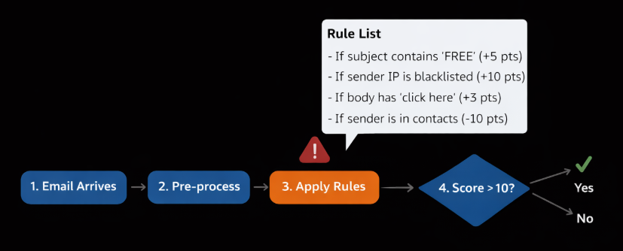
Why Use Machine Learning?
  Design of Spam filter using traditional programming
You have to manually define every single rule
All rules then are matched against the relevant attributes in the received email by the Detection Algo
With smarter Spammers, the list of rules becomes pretty complex and hard to maintain manually

Slide 11
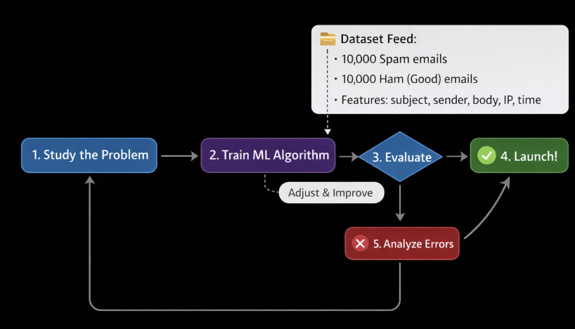
Why Use Machine Learning?
  Design of Spam filter using Machine Learning
You do not need to write explicit if-then rules.
You feed the algorithm enough examples (Spam vs Ham).
The algo writes the rules for you
Advantages
Automatic Adaptation
Handles high complexity
Lower maintenance

Slide 12
ML Applications
- Spam & phishing detection (email/SMS filtering)
- Fraud detection (banking, payments, insurance claims)
- Recommendation systems (products, videos, news, next-best-offer)
- Customer segmentation & personalization (marketing targeting, churn)
- Demand forecasting (sales, inventory, staffing)
- Revenue forecasting (monthly/quarterly/yearly with uncertainty bands)
- Predictive maintenance (machine failure prediction from sensor data)
- Quality inspection (computer vision) (defect detection on production lines)
Anomaly detection (system logs, network traffic, sensor drift)
And many more …

Slide 13
Dataset splitting: Train – validate - test
Training set
  This is the largest portion of your data (usually 70-80%). The algorithm "studies" this data to find patterns, correlations, and rules. It’s like a student reading a textbook to learn the subject.
Validation set
  This is a smaller slice (usually 10-15%). You use this during the training process to:
  Compare different models (e.g., "Is Model A better than Model B?").
  Fine-tune settings (hyperparameters).
  Check if the model is "overfitting" (memorizing instead of learning)

Slide 14
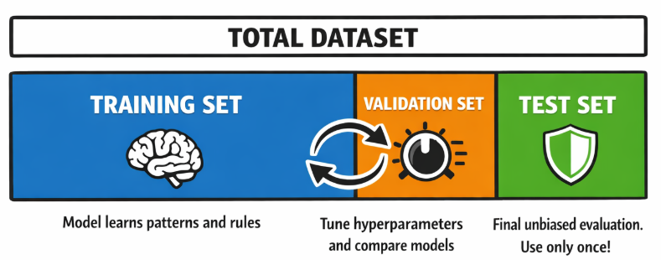
Dataset splitting: Train – Validate - Test
Test set
  This is the final 10-15% of data that the model has never seen before.
  You only use this once at the very end.
  It gives you the "real-world" accuracy of your model.
  If you use it during training, you are "cheating" because the model already knows the answers.
train
train
train

Slide 15
Types of Machine Learning Systems/Algorithms
Machine Learning Systems can be categorized based on:
  Learning style (supervision level)
  Learning time (when they learn)
  Learning method (how they learn)

Slide 16
Types of Machine Learning Systems/Algorithms
1. Learning Style
Supervised
Unsupervised
Semi-supervised
Self-supervised
Reinforcement Learning

Slide 17
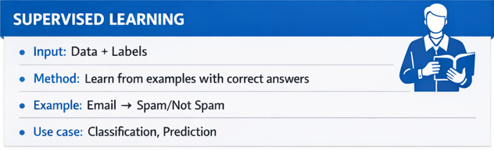
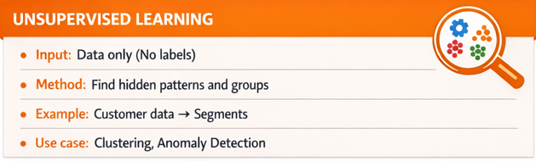
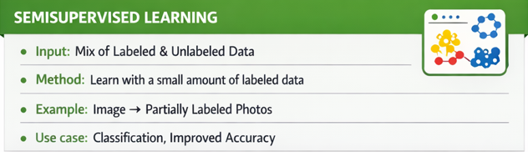
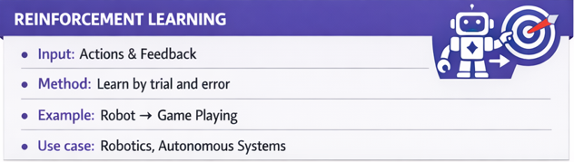
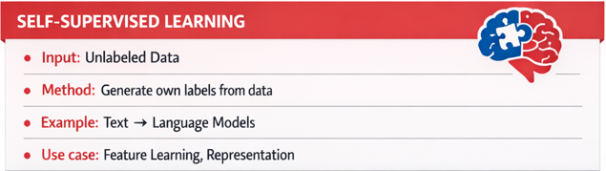
Types of Machine Learning Systems/Algorithms

Slide 18
1. Supervised Machine Learning
Supervised Learning
  You give both data and labels to the learning algorithm
  Right answers given to the learning algorithm
  10,000 emails, divided into Spam and Ham sets.
  Instructions to learn the difference
  Goal: predict label for new, unseen data
  Spam filtering, house price prediction, medical diagnosis from X-rays.
  Supervised Learning algorithms are further segregated based on the outputs they produce:
  Classification → discrete/categorical output
  Regression -> continuous output/ target numeric value

Slide 19
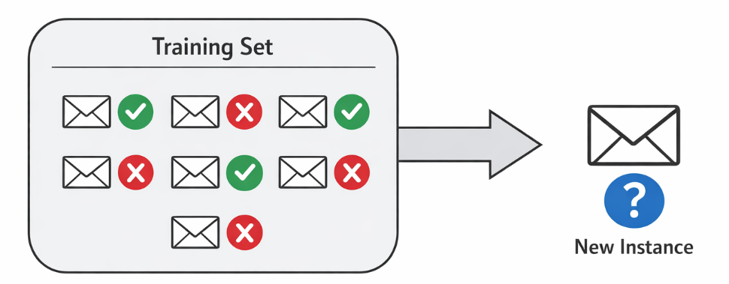
1. Supervised Machine Learning
Spam Filter: A typical case of classification

Slide 20
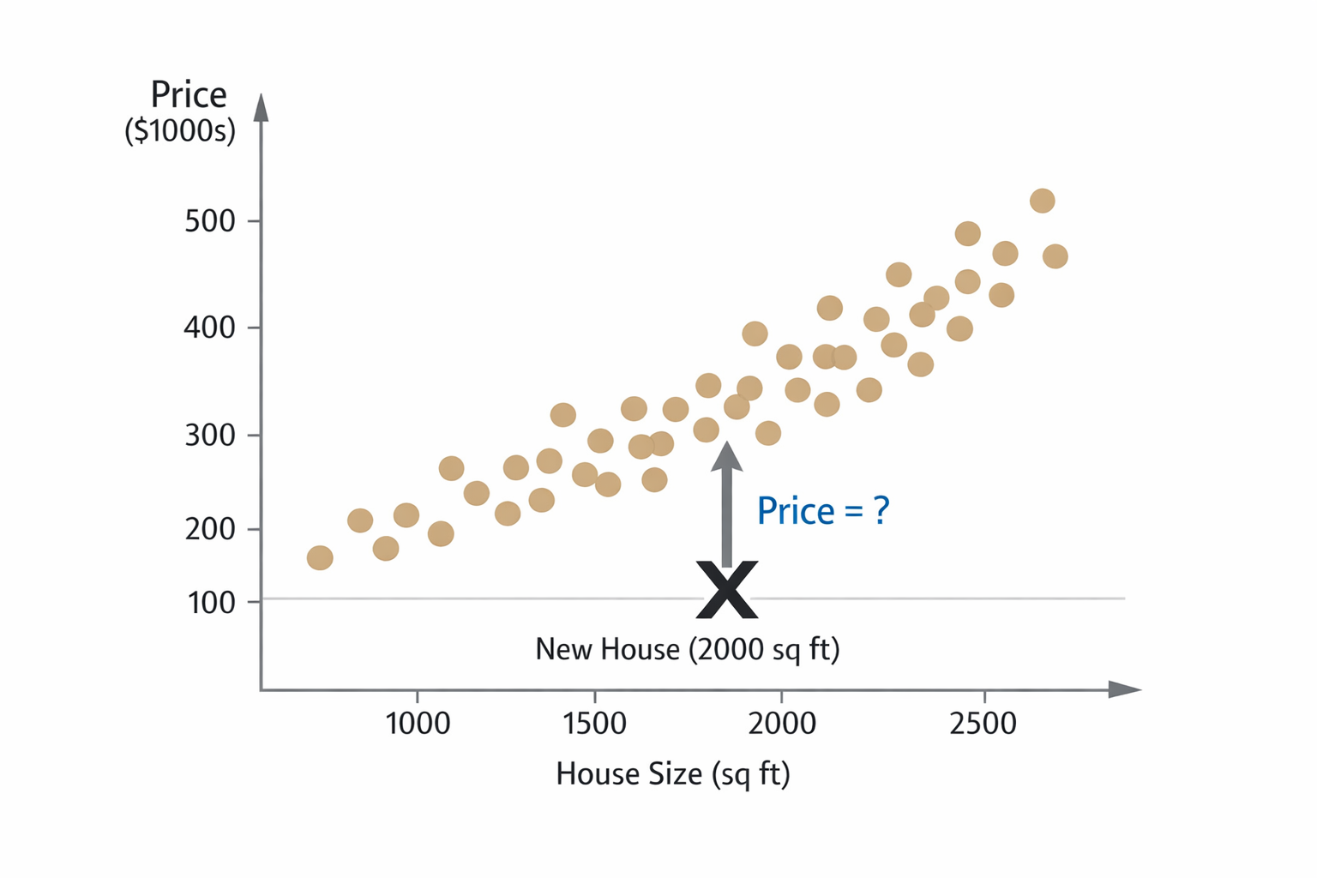
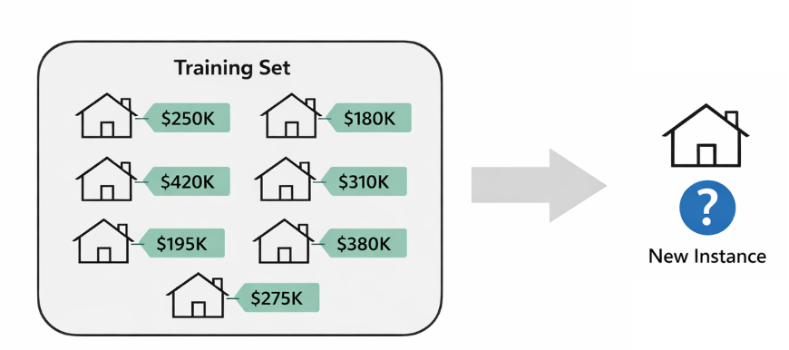
1. Supervised Machine Learning
House price prediction: A typical case of Regression

Slide 21
1. Supervised Machine Learning algorithms
List of supervised learning algorithms
  Classification (Binary vs multi-class)
  K-nearest neighbor classifier
  Linear regression
  Logistic regression
  Support vector machines (SVMs)
  Decision Trees
  Random forest
  Neural Networks

